Slide 1

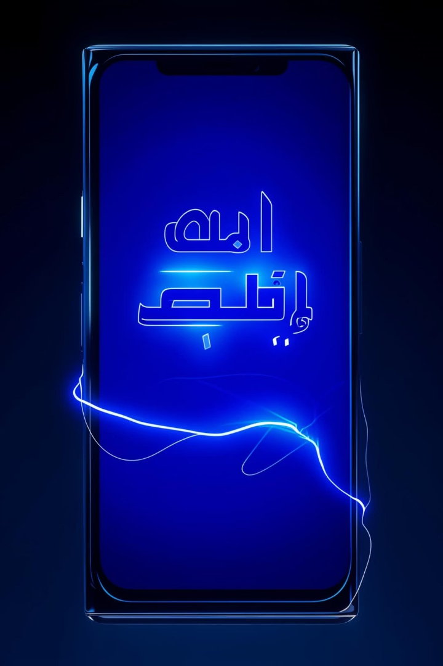
Arabic Sign Language Recognition
Supervised By
Dr. Amal Aboutabl

Slide 2

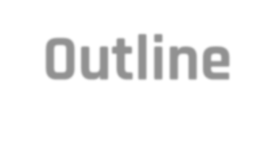
Outline
01
^{Introduction}
⁰⁶ Implementation Pipeline
Dataset: Creation, preprocessing,
& Augmentation
Experiment & Results
02
Problem Statement
State-of-the-Art Literature
Proposed Solution
07
03
08
04
09
Future Work
⁰⁵ Solution Design & Setup
¹⁰
Conclusion

Slide 3
It is a communication tool helping to bridge the gap between people with hearing impairments and general public.
Deaf and hard-of-hearing individuals use SL to interact with others through a vocabulary of signs and gestures In the past, people with disabilities did not receive global attention. However, today’s technologies offer tools designed to enhance the quality of life for individuals with disabilities.
As it depends on the language of the hands with specific movements, The approach is based on the use of SLR images, movements, and marks in the cameras’ vision.
INTRODUCTION & PROBLEM STATEMENT

Slide 4
STATE-OF-THE-ART LITERATURE
Approach | HOG + SVM | Kinematic features + HMM | Preprocessed CNN + data augmentation | Transfer Learning (InceptionV3)
Paper | Alfergani et al. (2013) | Al‐Mahadin & Jamous (2015) | Hussein et al. (2019) | Omar & El‐Sayed (2021)
Dataset & Reported Accuracy | 1,000 images, 32 ArSL letters 76.4 % accuracy | 15 video sequences, continuous ArSL 68.2 % word‐level recognition | ArASL; varied illumination 82.7 % test accuracy | ArASL + synthetic images 88.3% validation accuracy

Slide 5
PROPOSED SOLUTION
Our end-to-end solution consists of three major phases: Data Preparation & Preprocessing, Model Development & Selection, and Application Integration. Each phase contains clearly defined sub-steps to ensure reproducibility, robustness, and maintainability.
Data Preparation & Preprocessing
Dataset Ingestion: Load the ArASL dataset (7,856 RGB images, 33 classes) and accompanying labels apply the necessary preprocessing steps.
e.g. Resizing: 64×64 for CNNs; 224×224 for MobileNetV2, Noise Reduction: Apply Gaussian blur or median filtering to reduce sensor noise, and Data Augmentation.
Model Development & Selection
MobileNetV2 Transfer Learning.
Application Integration
Model Export: Convert the selected model to TensorFlow Lite (TFLite) format for on-device inference.

Slide 6



Our Solution: Automated ArSL Recognition
Deep Learning
Mobile Integration
Gesture to Text
Compare CNN, Enhanced CNN, MobileNetV2 , VGG , YOLO, and MediaPipe+BiLSTM .
Translate hand-gesture images to Arabic letters.
Two-way communication via mobile app.

Slide 7
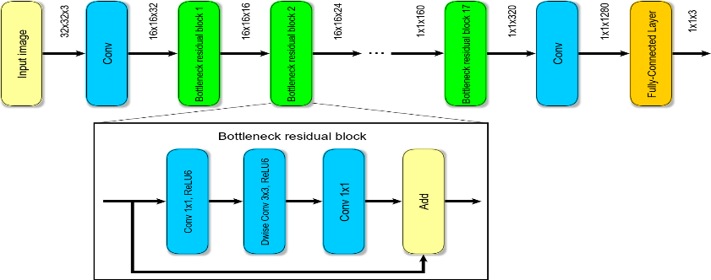
SOLUTION DESIGN & SETUP
MobileNetV2 Architecture
.

Slide 8
SOLUTION DESIGN & SETUP contd.
MobileNetV2: MobileNetV1 emerged as a family of computer vision neural networks designed to support classification and detection in standard functions primarily built for mobile devices. It can run these networks on mobile devices, enhancing user experiences by providing benefits such as always-on access, privacy, security, and power efficiency. Subsequently, MobileNetV2 was introduced to power the next generation of mobile computer vision applications. MobileNetV2 represents a significant improvement over MobileNetV1 and incorporates the latest technology for mobile optical recognition, including support for various convolutional neural network applications such as object detection, classification, and semantic segmentation. Released as part of the TensorFlow-Slim image classification library, MobileNetV2 builds on ideas from MobileNetV1, using separate depthwise convolutions as efficient building blocks. Additionally, MobileNetV2 introduces new architectural features, including linear bottlenecks between layers and shortcut connections between bottlenecks.

Slide 9
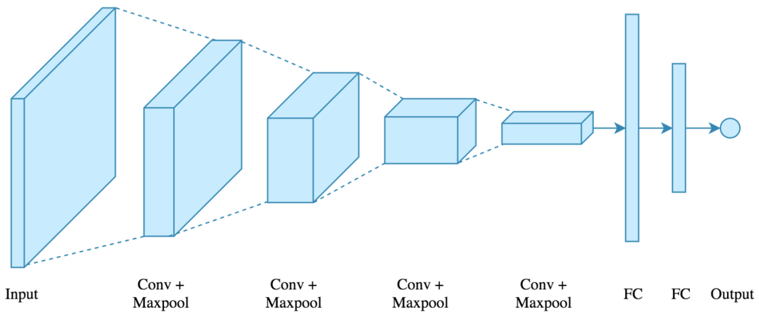
SOLUTION DESIGN & SETUP contd.
Convolution Neural Network
Architecture
As it is known in computer science, deep learning or CNN is the best technique that can be used for a recognition system. According to the previous most-used deep learning trained architectures are MobileNet-V2 among others.
CNN can be fed raw image pixel values rather than pre-processed feature vectors, unlike standard machine learning applications. The general architecture of CNN. CNN’s usual architecture is made up of layers of computing units (gates).

Slide 10


DATASET: CREATION, PREPROCESSING & AUGMENTATION
The used dataset comprises 7856 images depicting Arabic Sign Language letters. These images were contributed by over 40 individuals and cover 33 standard Arabic signs and letters(Classes)
Preprocessing
Data was normalized and resized to the shape of 224x224.
Image Enhancement Pipeline
Resizing: 64×64 for CNNs; 224×224 for MobileNetV2.
Normalization: Scale pixel values to [0,1]; compute per-channel mean/std on the training set.
Noise Reduction: Apply Gaussian blur or median filtering to reduce sensor noise.
Contrast Adjustment: Use histogram equalization or CLAHE to mitigate lighting variance.
.
Data Augmentation
Implement on-the-fly transformations—random rotations (±15°), horizontal flips, zooms (±10 %), shifts (±10 %), and brightness jitter (±20 %)—to increase variability and reduce overfitting.

Slide 11
DATASET: CREATION contd.
The dataset was divided into training, validation, and testing sets with 80% ratio for training and 10% for testing and finally 10% for validation. The training set was entered into 3 different chosen models, leveraging their efficiency and robustness in extracting complex patterns from data

Slide 12
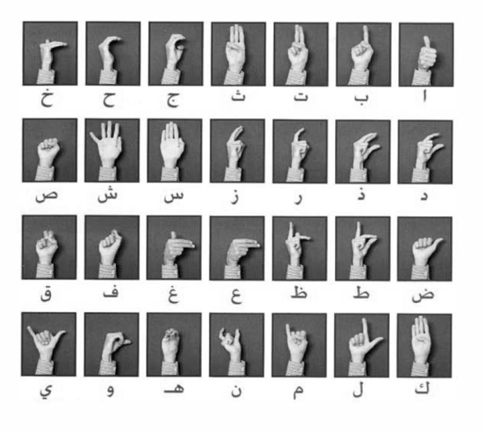
DATASET: CREATION contd.
Examples of the training data.

Slide 13
Work Plan (Gantt Chart)
■ = Active phase for each task.
Task | November | December | February | March | April | May
1. Data collection & inspection | ■■■■
2. Data Preprocessing |  | ■■■■
3. Basic CNN development & tuning |  | ■■■ | ■■
4. Enhanced CNN development & tuning |  |  | ■■ | ■■■
5. MobileNetV2 fine-tuning |  |  | ■■ | ■■■■ | ■■■
6. Model evaluation & selection |  |  | ■■ |  | ■■■■
7. Mobile app & 3D avatar integration | ■■■■ | ■■ | ■ | ■■■ | ■■ | ■■■
8. Report writing & presentation prep |  |  |  |  | ■■ | ■■

Slide 14
Training on 2 phases for more robust model
First phase for 30 epochs
Second phase for 25 epochs
Input shape 224x224
Define English to Arabic mapping for labels to be used in label encoder.
Split data Train/Val/Test split (80/10/10) for true unseen evaluation.
converting from BGR to RGB because Pre-trained models are trained on RGB images.
Adam Optimizer
Learning rate 0.001
Batch Size of 32
Reduce Learning Rate Regularization.
Early Stopping Regularization.
dropout rate (0.3).
Compute Balance Class Weight
EXPERIMENT & RESULTS: MODEL INITIALIZATION

Slide 15
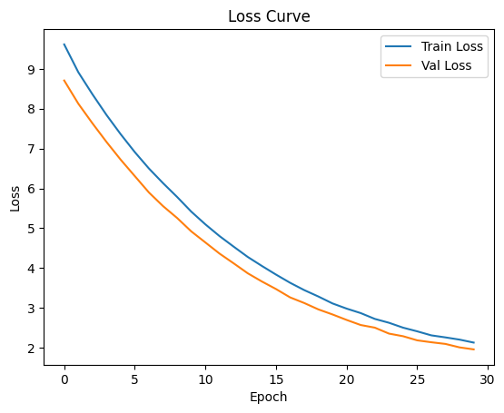
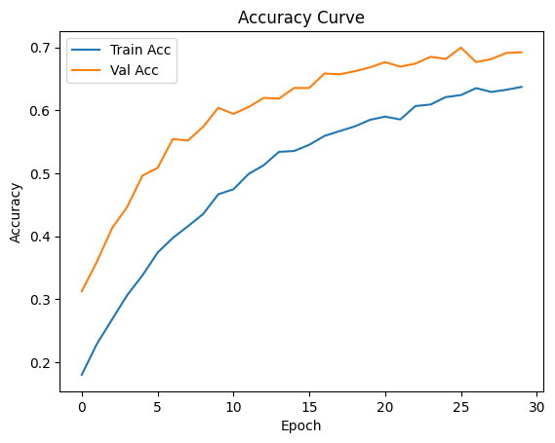
EXPERIMENT & RESULTS: Visualizations for MobileNetV2
Loss Curve
Accuracy Curve

Slide 16
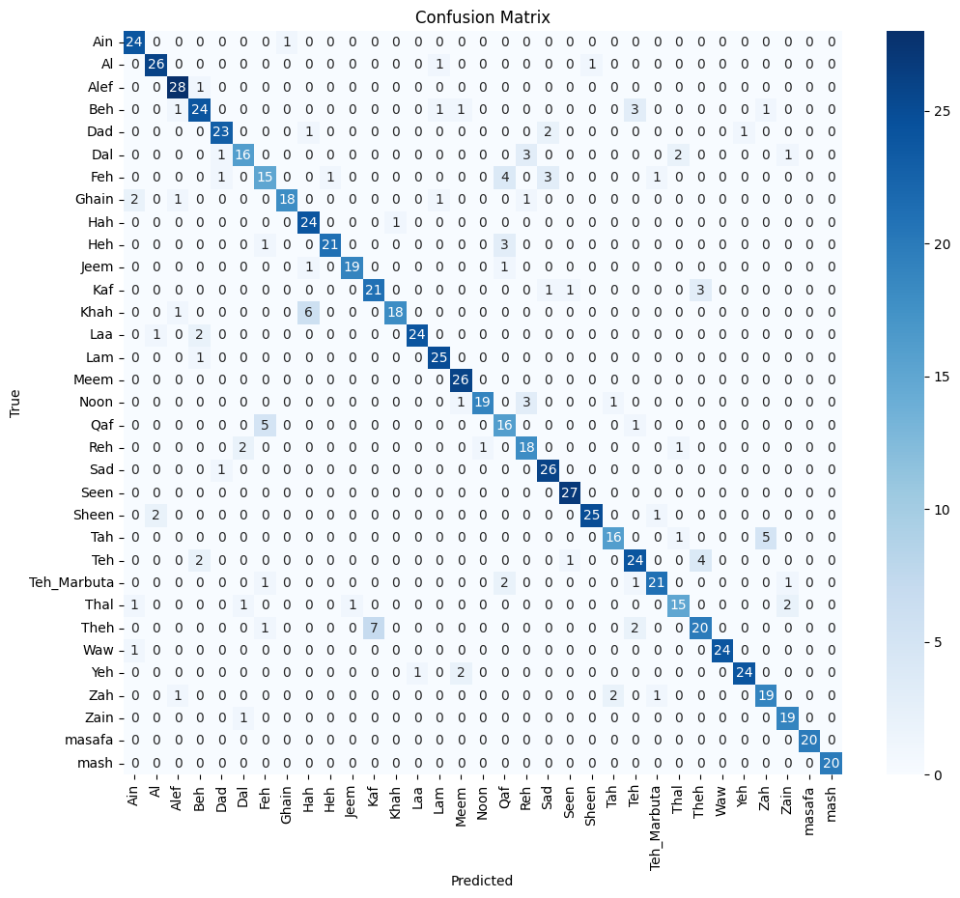
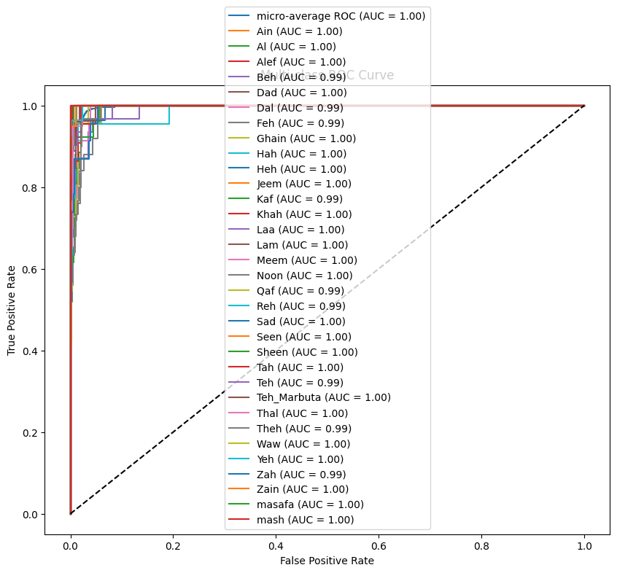
EXPERIMENT & RESULTS: Visualizations for MobileNetV2 contd.
Confusion Matrix
Multi-Class ROC Curve

Slide 17
EXPERIMENT & RESULTS: RESULTS
Test Accuracy: 87.77%
Validation Accuracy: 85.35%
Sample of the Real Time output

Slide 18
EXPERIMENT & RESULTS: MODELS PERFORMANCE
Model | MobileNetV2 | Basic CNN | Enhanced CNN
Test Accuracy in Percentage | 87.77% | 79.06% | 82.69%

Slide 19
MODEL TESTING
Technique | Accuracy | Language | Dataset | Dataset size
CNN with a basic Preprocessing | 79.06% Test accuracy | Arabic | RGB Arabic Alphabets Sign Language | 7,857 images
Preprocessed CNN | Recognition accuracy of 82.69% | Arabic | RGB Arabic Alphabets Sign Language | 7,857 images
Pre-Trained MobileNetV2 | Top-1 Recognition accuracy of 87.77% | Arabic | RGB Arabic Alphabets Sign Language | 7,857 images

Slide 20
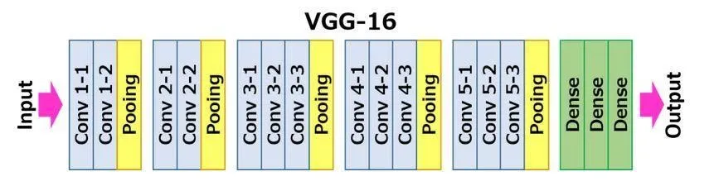
SOLUTION DESIGN & SETUP contd.
VGG16 Architecture
VGG16 architecture, a well-known deep convolutional neural network developed by the Visual Geometry Group (VGG) at Oxford University. VGG16 is characterized by its simplicity and depth, consisting of 13 convolutional layers and 3 dense (fully connected) layers, utilizing 3×3 convolution filters and 2×2 max-pooling throughout a fixed structure.

Slide 21
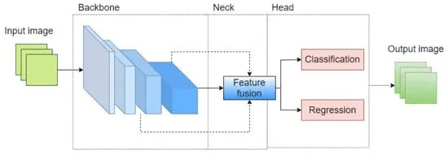
SOLUTION DESIGN & SETUP contd.
YOLOv10 Architecture
YOLOv10 (You Only Look Once version 8) is an advanced object detection model designed for real-time applications. It leverages the following architecture components: ● Backbone: CSPDarknet for feature extraction. ● Neck: PANet for feature aggregation across multiple scales. ● Head: Detection head responsible for predicting bounding boxes, objectness scores, and class probabilities.

Slide 22
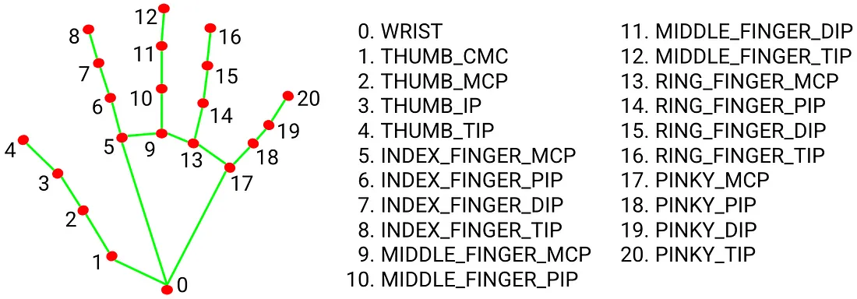
SOLUTION DESIGN & SETUP contd.
Mediapipe is a popular open-source framework for building computer vision and machine learning pipelines. It includes a pre-trained hand landmark model that can detect and track the positions of specific points on a person’s hand. MediaPipe Hands is a high-fidelity hand and finger tracking solution. It employs machine learning (ML) to infer 21 3D landmarks of a hand from just a single frame. MediaPipe Hands utilizes an ML pipeline consisting of multiple models working together: A palm detection model that operates on the full image and returns an oriented hand bounding box. A hand landmark model that operates on the cropped image region defined by the palm detector and returns high-fidelity 3D hand keypoints.
Hand landmarks

Slide 23
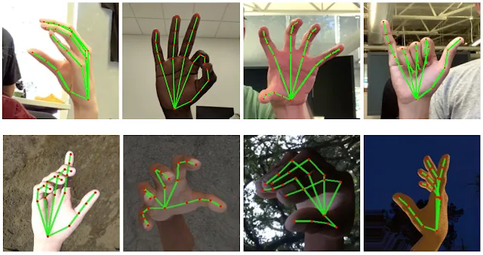
SOLUTION DESIGN & SETUP contd.

Slide 24
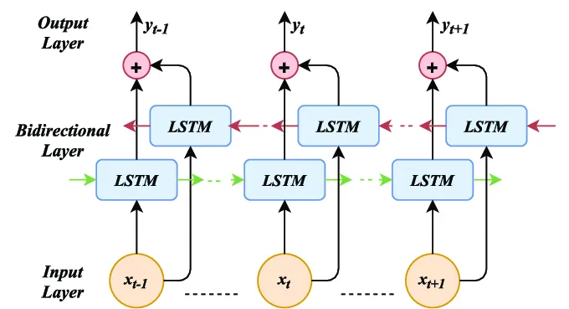
SOLUTION DESIGN & SETUP contd.
Bidirectional Lstm Architecture
Bi-LSTM (Bidirectional Long Short-Term Memory) is a type of recurrent neural network (RNN) that processes sequential data in both forward and backward directions. It combines the power of LSTM with bidirectional processing, allowing the model to capture both past and future context of the input sequence

Slide 25
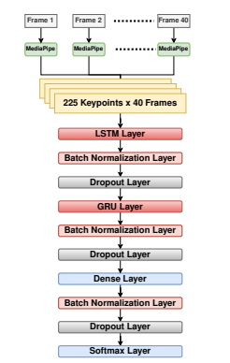
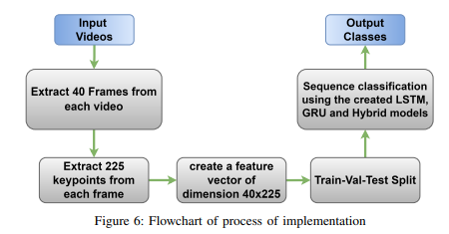
SOLUTION DESIGN & SETUP contd.

Slide 26
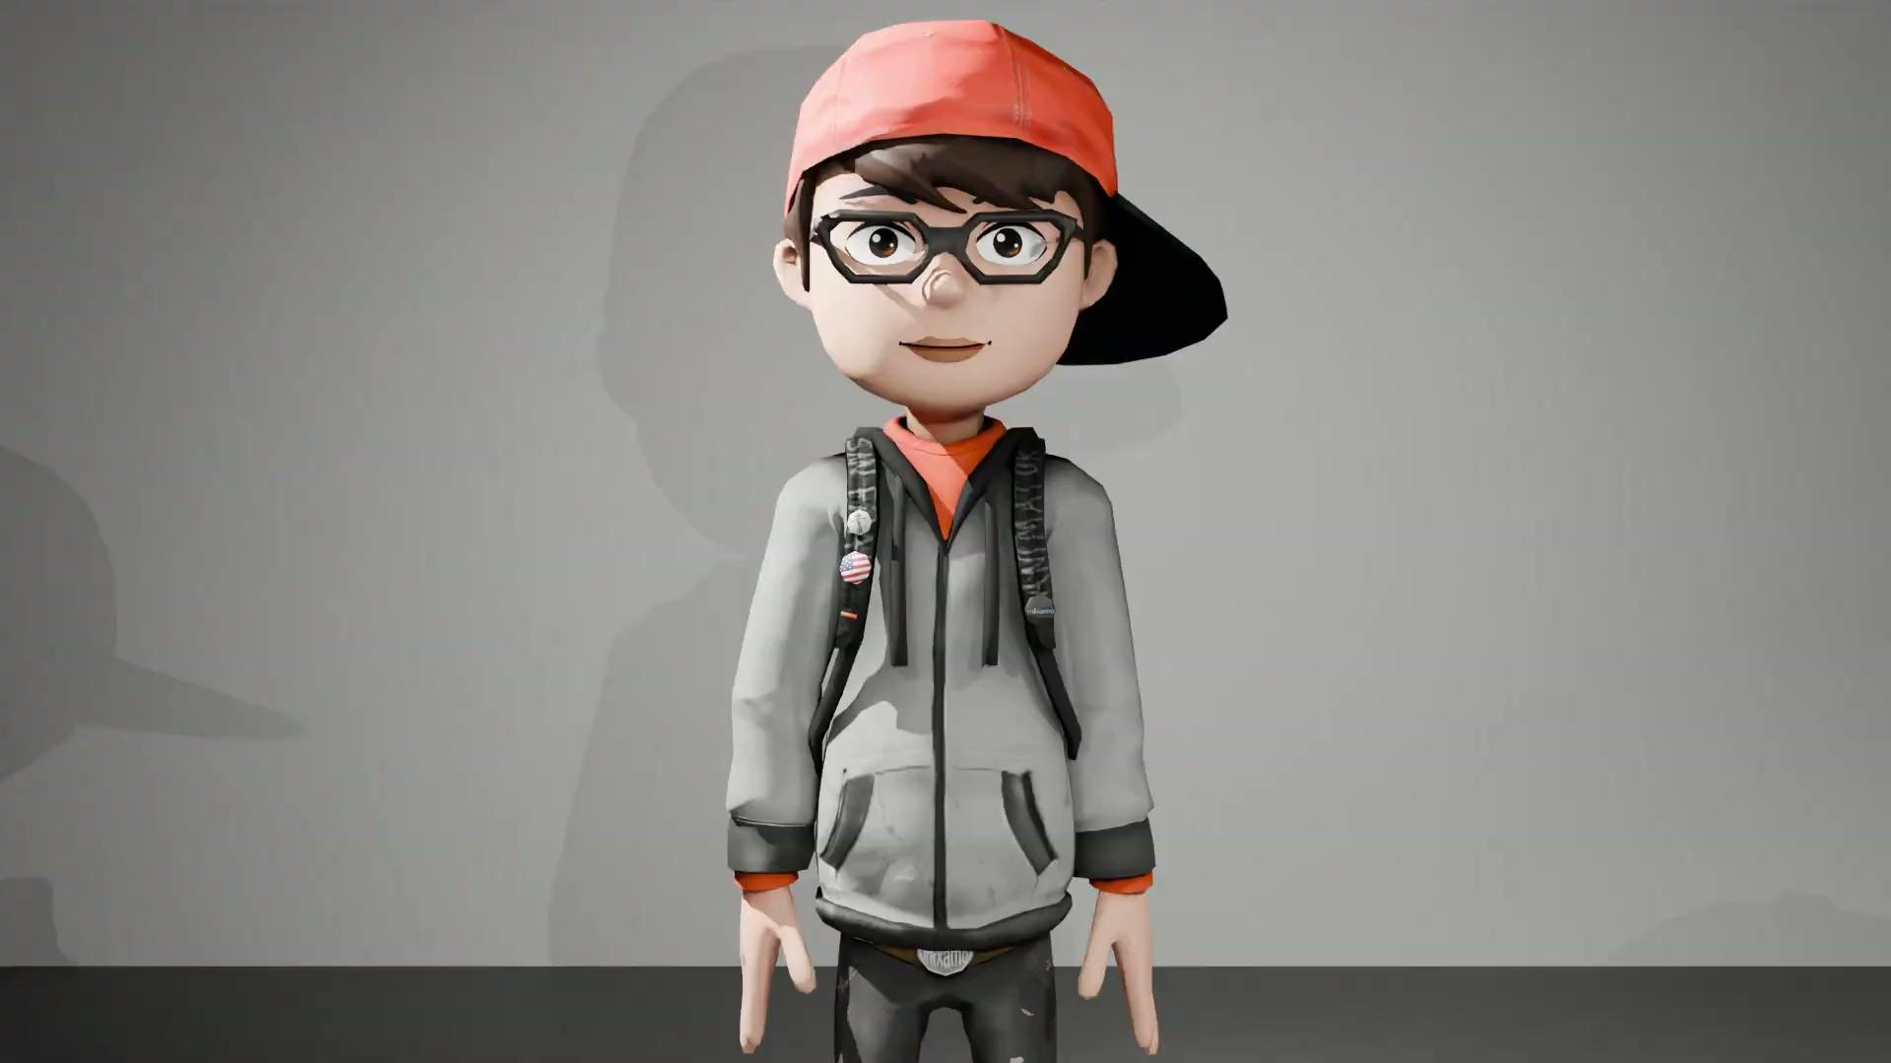
SOLUTION DESIGN & SETUP contd.
Text-to-Sign Animation with an Avatar
“To facilitate two-way communication, our system translates user-entered Arabic text into sign language using a 3D animated avatar.” Purpose: Help hearing individuals communicate with deaf users. Technology: Animated avatar performs signs in real-time or pre-rendered.
(Sign Language Animation Blender, Unity)

Slide 27
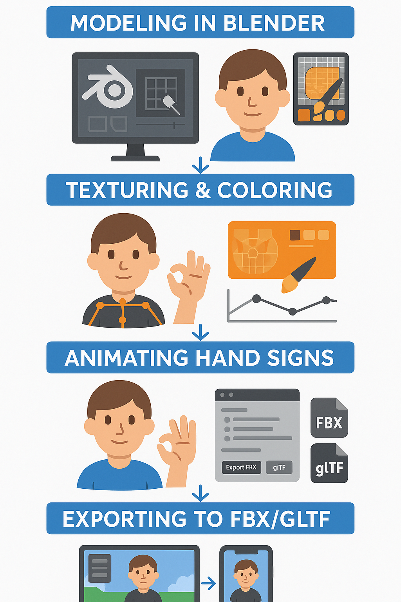
🔹 Workflow Overview
1. 3D Modeling (Blender)
2. Texturing & Coloring
3. Rigging (Armature & Bones)
4. Animating Hand Signs
5. Exporting to FBX/GLTF
6. Integrating with Unity/Mobile App

Slide 28
🔹 3D Modeling in Blender
Step 1 – 3D Modeling in Blender
- Created the character model from scratch.
- Designed head, body, hands, and accessories in Blender.
- Used cartoon-style proportions for expressiveness.
Step 2 – Texturing & Coloring
- Applied colors and materials using Blender Shader Editor.
- Designed outfit, skin tone, and visual consistency.
- Focused on clarity and readability.
Step 3 – Rigging the Avatar
- Added full-body skeleton (Armature).
- Used Rigify for auto rigging with manual finger tweaks.
- Enabled smooth control over hand movements.
Step 4 – Animation of Hand Signs
- Created Keyframe animations for Arabic letters.
- Used Timeline and Dope Sheet in Blender.
- Exported each animation separately.
Step 5 – Export & App Integration
- Exported avatar and animations as FBX/GLTF.
- Integrated using Unity for real-time rendering.
- Linked Arabic text input to avatar animation.

Slide 29
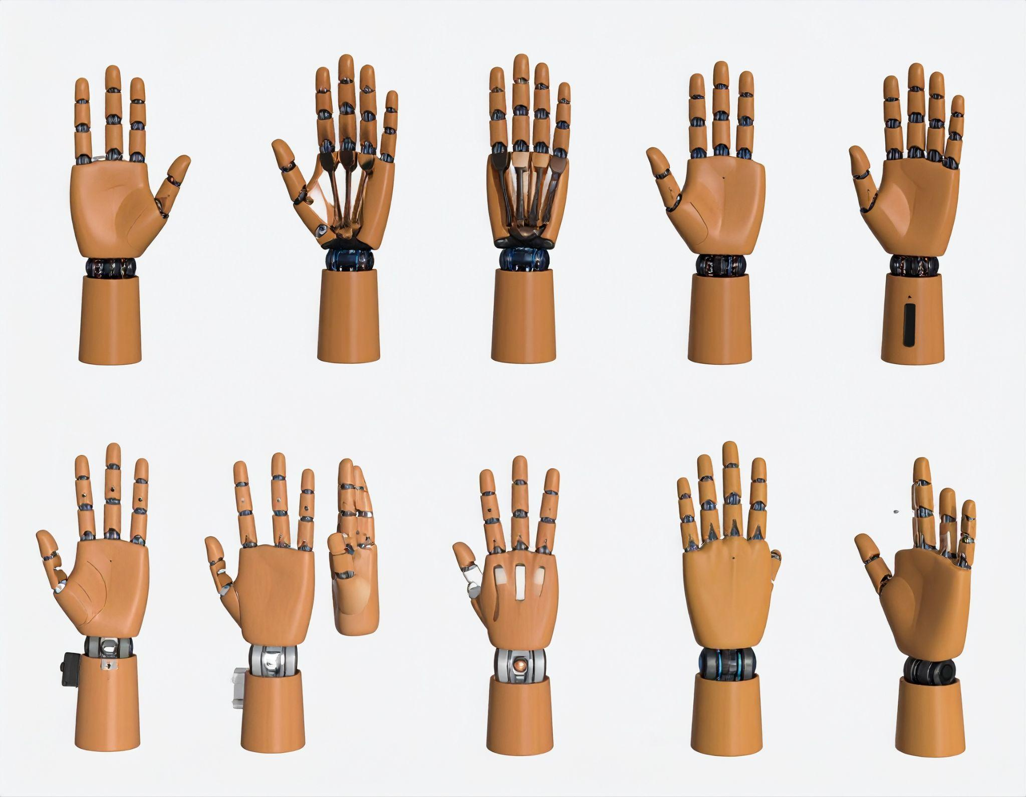
🔹 Why Use a 3D Avatar?
- Bridges communication between deaf and hearing users.
- Visual and interactive.
- Suitable for children and learning environments.

Slide 30
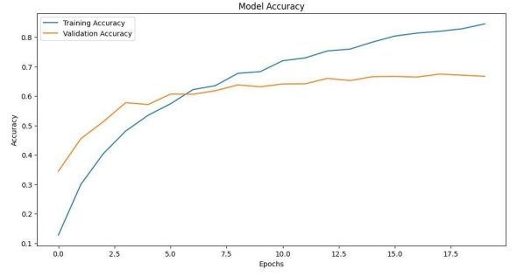
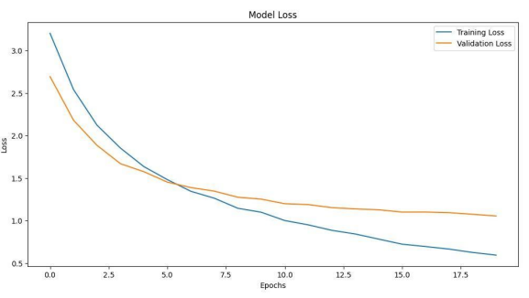
EXPERIMENT & RESULTS: Visualizations for VGG16 Architecture contd.
Loss
Accuracy

Slide 31
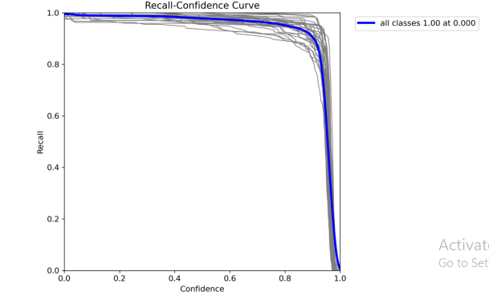
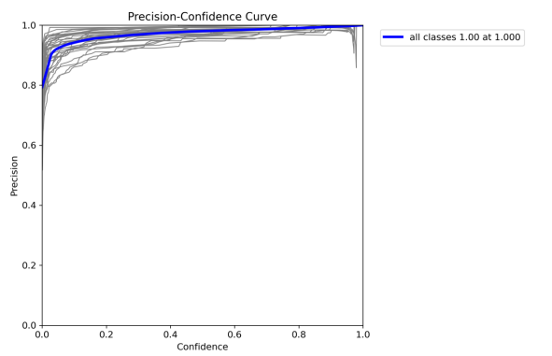
EXPERIMENT & RESULTS: Visualizations for YOLOv10 Architecture contd.

Slide 32
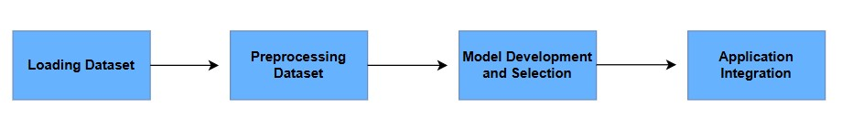
SOLUTION PIPELINE

Slide 33
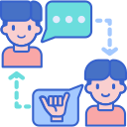
Application OverView
We make this application to target the Deaf and mute people and normal people to can communicate with normal people by convert their sign to text and convert their text to sign and make their life easier.
So we will cover together the normal app feature and the customize feature we did for them.

Slide 34
We will start now with the normal feature we have as a normal chat application
Authentication
Edit profile
Add contact
Real-time functions
Home &Search
Favorite
Block
Show the receiver page
Voice recording

Slide 35
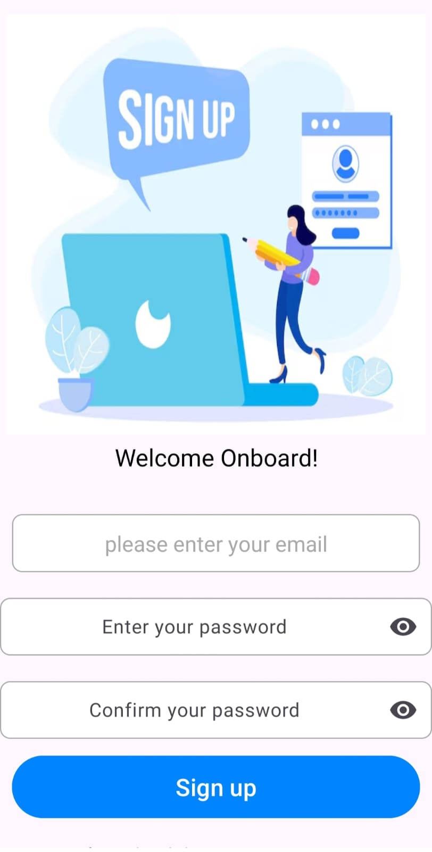
Authentication
We use for authentication sup abase because we want a
structured SQL database for integrate it
with other authentication functions.
Our authentication function :-
Log in
Sign up
Forget password
Sign up function takes the Email of the user and the password and confirm it and save in the sup abase authentication users

Slide 36
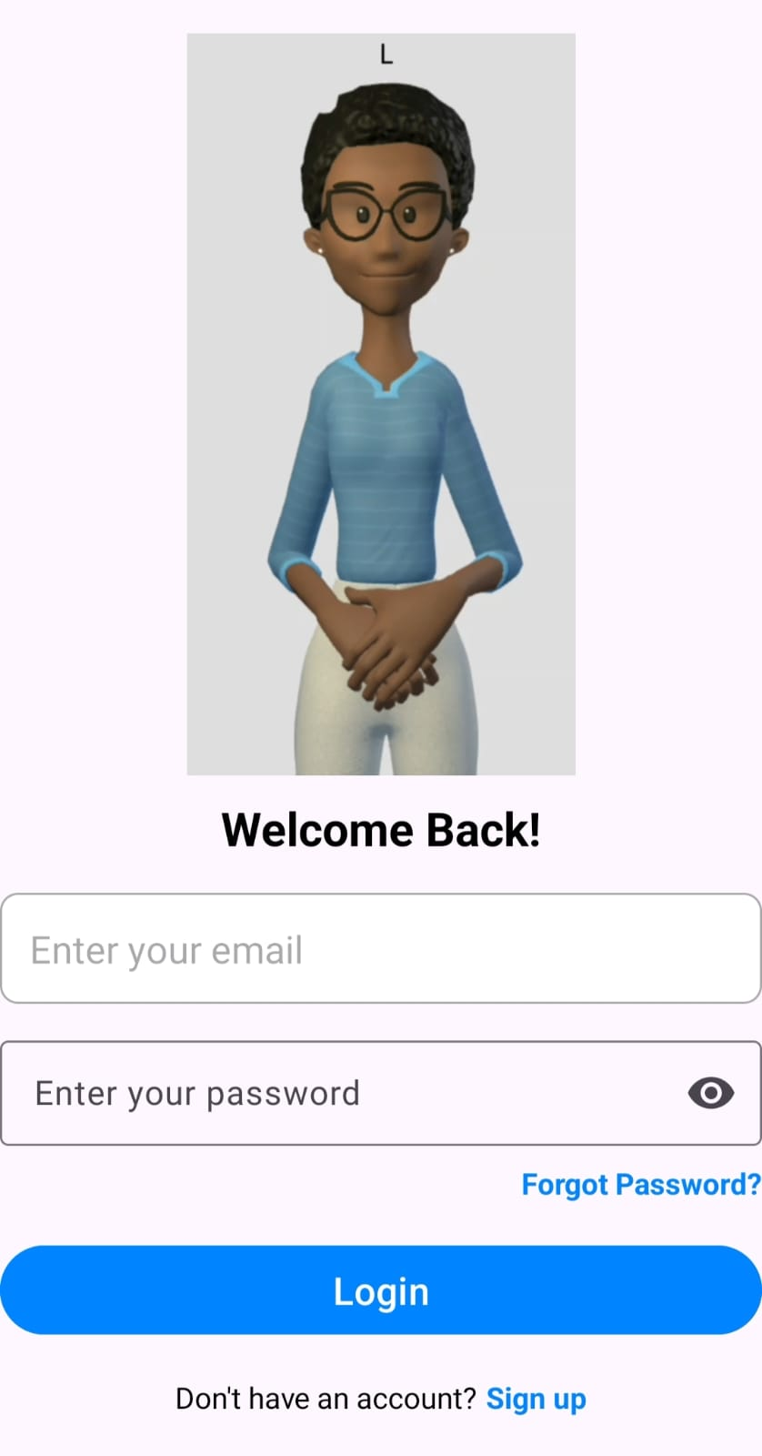
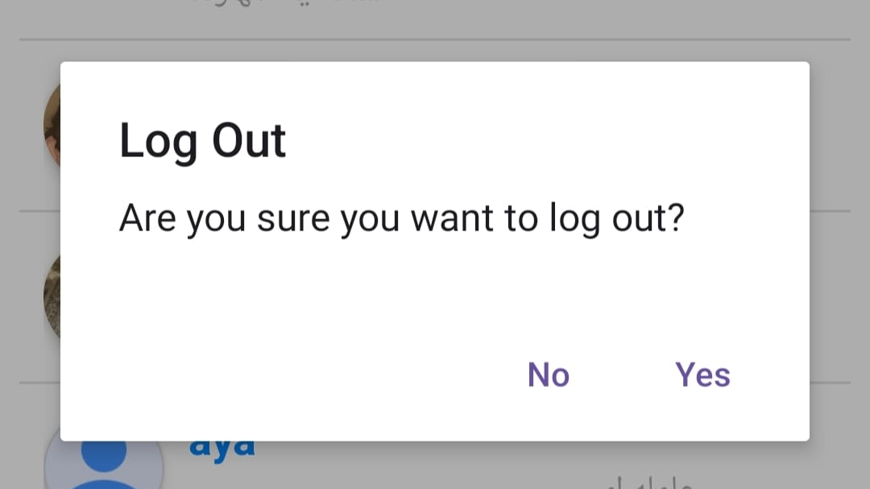
The other Authentication methods:-
Log in when the user try to log in he enters only the email
and the password and the sup abase authentication
automatically validate it with avatar welcome it.
Log out when the user ask for logging out from the account the sup abase also handle it

Slide 37
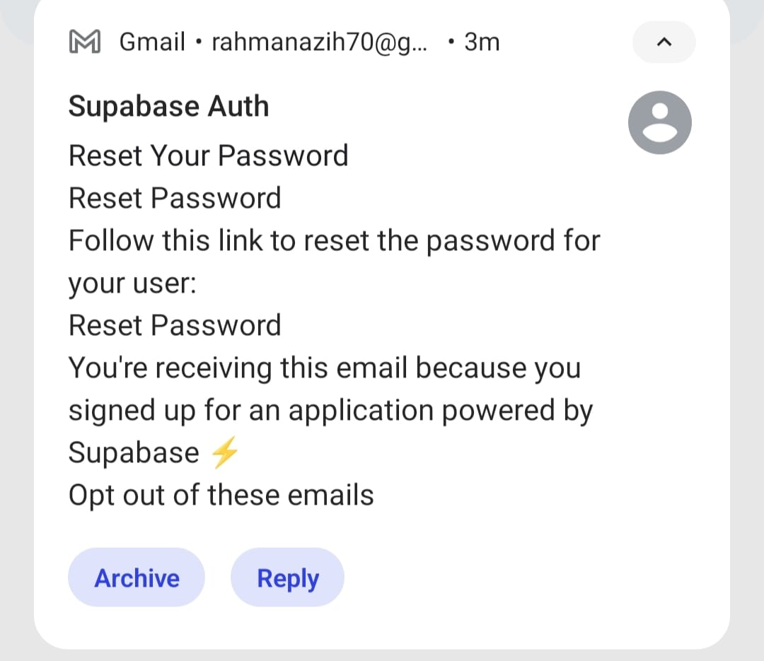
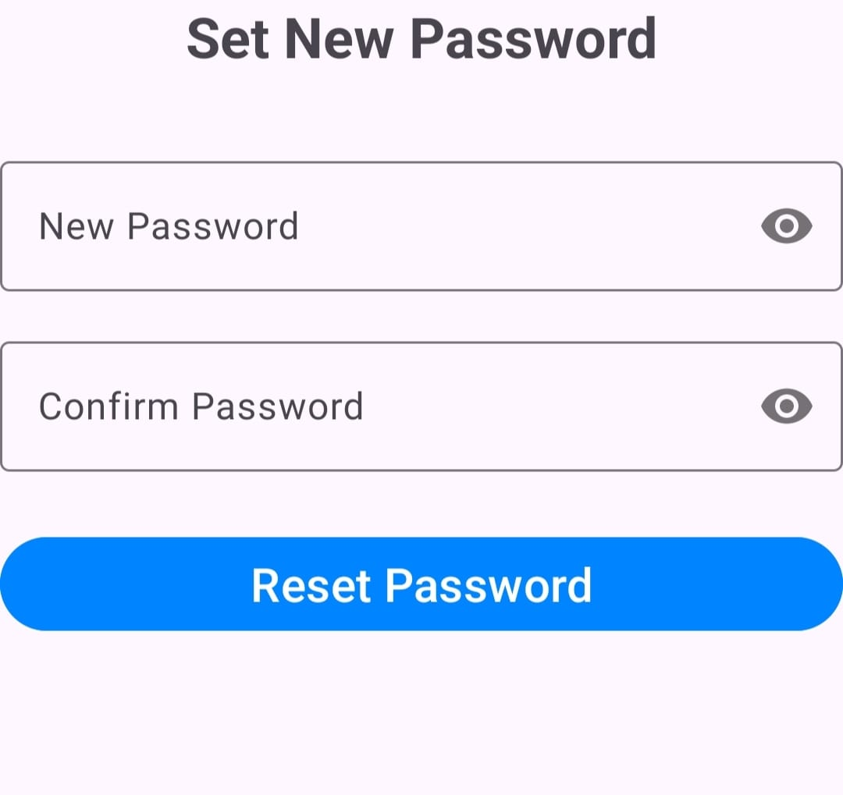
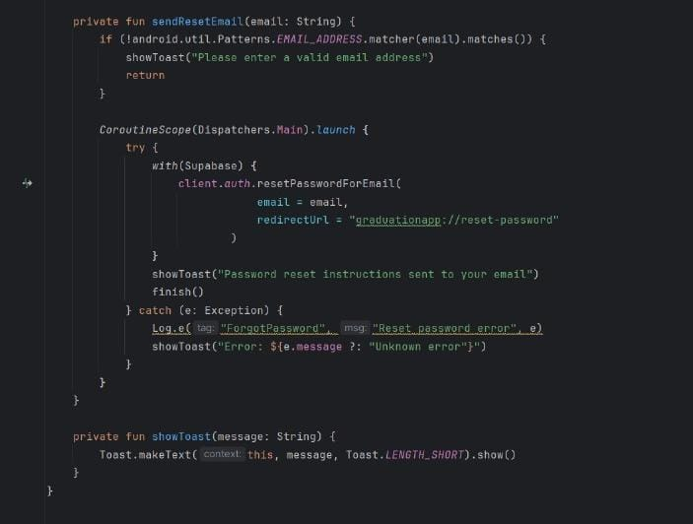
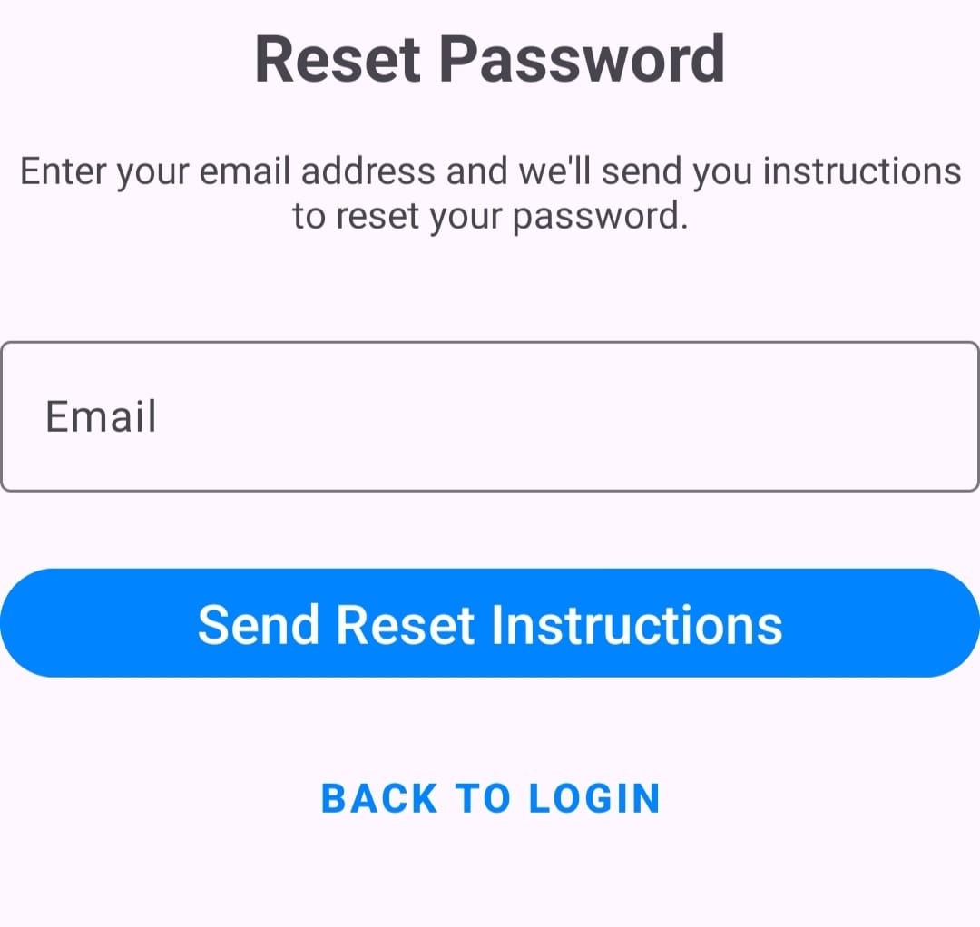
The follow of reset password
Activities :-
Reset_password
When the user ask to
forget password and
enter the email the
sup abase sent
instructions by his
email and redirect the
user to reset activity to
correctly change the
password and
log in again

Slide 38
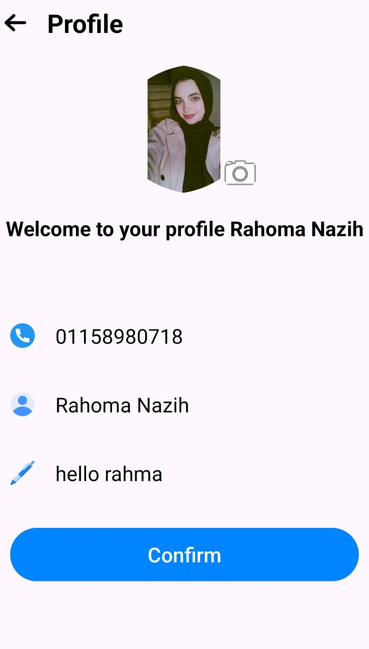
Profile page
When the user log in for the first time the app automatically
intent to the profile page to enter all essential data that will
storing in supabase and using it for all functions in
app and then intent to home again.
Enter and edit profile image
The phone number
The bio
The name of the user

Slide 39
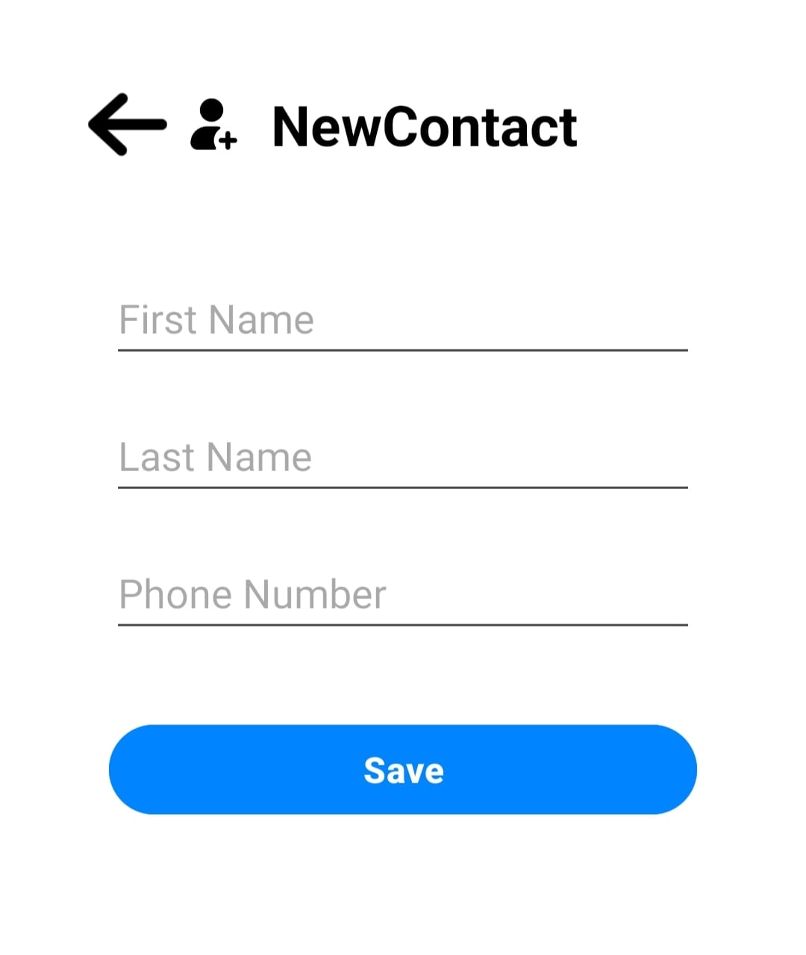
Add Contact Activity :-
Which the user can add new contact and save it in his device and we can navigate to this by floating action button from the home page.

Slide 40
Real-time Function:-
We first will take about the database of supabase we storing the data in it that is responsible for all real time functions by focus on the Usid
(is that unique and auto-generated and use as sender or receiver id)
Functions:-
Real time messages
Display all recent chats
Video calls
Audio calls

Slide 41
The schema first in supabase :-
The database is designed for a chat application. The main table is user_data, which stores user information like uid, name, phone number, bio, profile image URL, status, and last seen timestamp.
The friends table stores friend relationships using us_id and friend_id, along with the creation timestamp.
The favorites table stores favorite users with the same structure: us_id, favorite_id, and created_at.
The block_list table keeps track of blocked users using us_id (the blocker) and blocked_id (the blocked), plus the timestamp.
The messages table holds all messages sent between users, including sender_id, receiver_id, the message content, and the timestamp.

Slide 42
Real time messages:-
The chat application implements real-time messaging using Firebase Realtime Database, with the core logic managed in the Message ViewModel class. When a user initiates a chat, a listener is established on the messages node, filtered by the chatId, to receive real-time updates. This includes automatically handling newly added messages, updated messages, and deleted messages without requiring manual refreshes. The application supports sending messages by creating a message object that includes the sender and receiver IDs, the message text, a timestamp, and a unique ID, which is then stored in the database. Additionally, the chats node is updated with the latest message and metadata to enable chat previews in a conversation list. The system also supports deleting messages, where only the sender is authorized to remove their own messages, and the chat preview is updated accordingly. To enhance the user experience, the app marks incoming messages as read once viewed, updating their status in the database. LiveData properties are used to keep the user interface in sync with backend changes, ensuring that all updates appear instantly and consistently in the chat view.

Slide 43
Display all recent chats:-
Other user’s profile from Supabase and shows their name, image, last message, and time. Chats are sorted with unread ones first, then by most recent, and displayed using a RecyclerView and ChatAdapter.
HomeActivity shows user profile at the top, includes bottom navigation (Favorites, Block List, Profile, Logout, Home), uses ViewPager with tabs (Chats, Calls), and has two FABs (Add Contact, Guess Word Game). It supports custom sign language keyboard and handles search input.
Search: When search icon is clicked, it shows a search input and hides other views. Typing triggers search via Home ViewModel, and results are shown in a RecyclerView. Selecting a result opens the chat screen with that user.

Slide 44
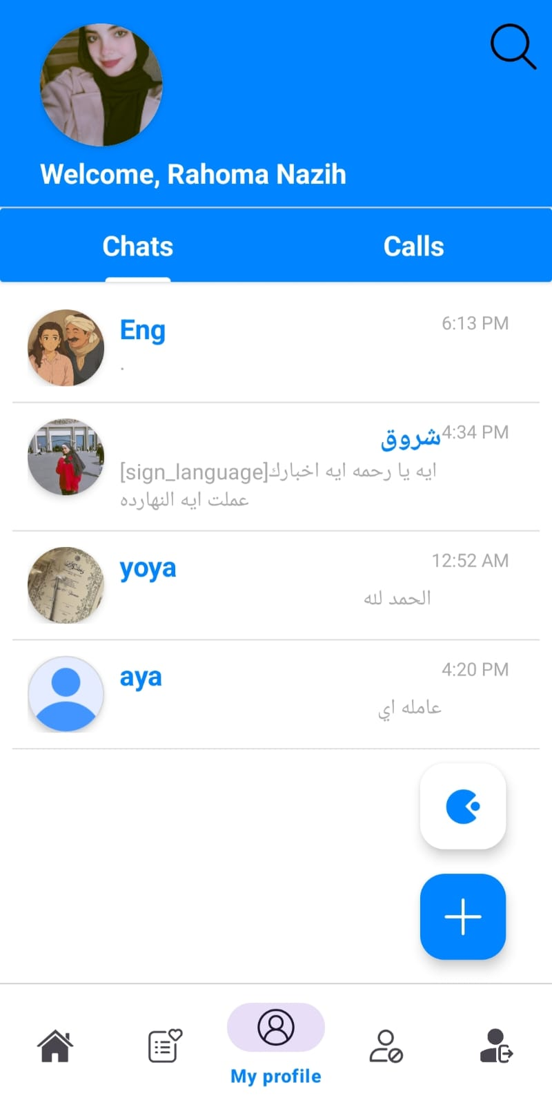
The Home Page View:-

Slide 45
The Customize features :-
Avatar for all application
Convert text message to avatar
Custom Arabic & English Keyboard
Guess the word

Slide 46
Avatar for all application:-
In our app, you enabled a smart sign language avatar feature where any Arabic or English text can be long-pressed to play a corresponding sign language video. This was achieved by creating a Base Sign Language Activity that automatically scans all TextViews on the screen and enables long-press detection via Sign Language TextHelper.enableSignLanguageSupportForAllTextViews(rootView). When a user long-presses a word, it triggers the Sign Language Video Manager, which maps each Arabic or English character (uppercase or lowercase) to a corresponding video (videoMap), prepares a queue of letter videos with prepareVideosForText(), and plays them in order using startPlayback() and playNext Video(). The system smoothly plays letter-by-letter videos using a VideoView, with support for stopping playback using stop()
The same idea in the message adapter to convert the message to sign

Slide 47
The View & Hot lines in implementation:-
Inheritance for Global Support
open class BaseSignLanguageActivity : AppCompatActivity()
Enable Sign Language on All TextViews Automatically
val rootView = findViewById<View>(android.R.id.content)
SignLanguageTextHelper.enableSignLanguageSupportForAllTextViews(rootView)
Mapping Characters to Sign Language Videos
private val videoMap = mapOf( 'ا' to R.raw.alaf, 'A' to R.raw.a, 'b' to R.raw.b, // ...)

Slide 48
The View & Hot lines in implementation:-
Queue Preparation for Text Playback
fun prepareVideosForText(text: String) {videoQueue.clear()text.toLowerCase().forEach { char ->
videoMap[char]?.let { videoQueue.add(it) }
}
}
Recursive Playback of Letter Videos
val nextVideoRes = videoQueue.poll()
if (nextVideoRes == null) { onComplete(); return }

Slide 49
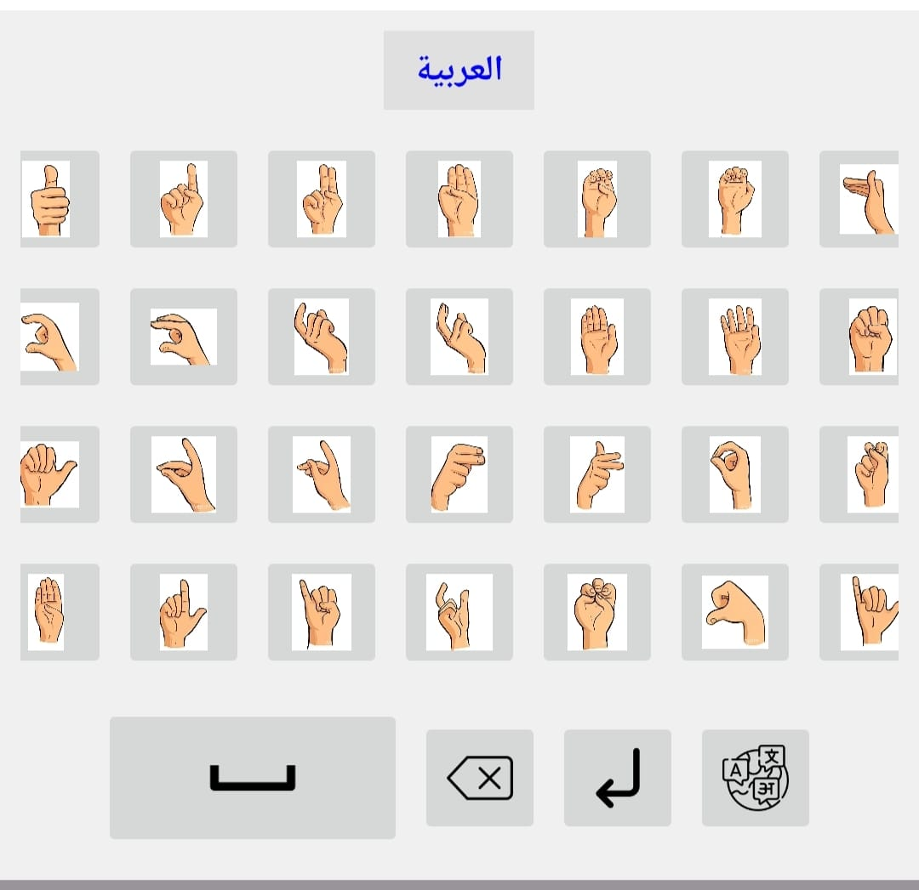
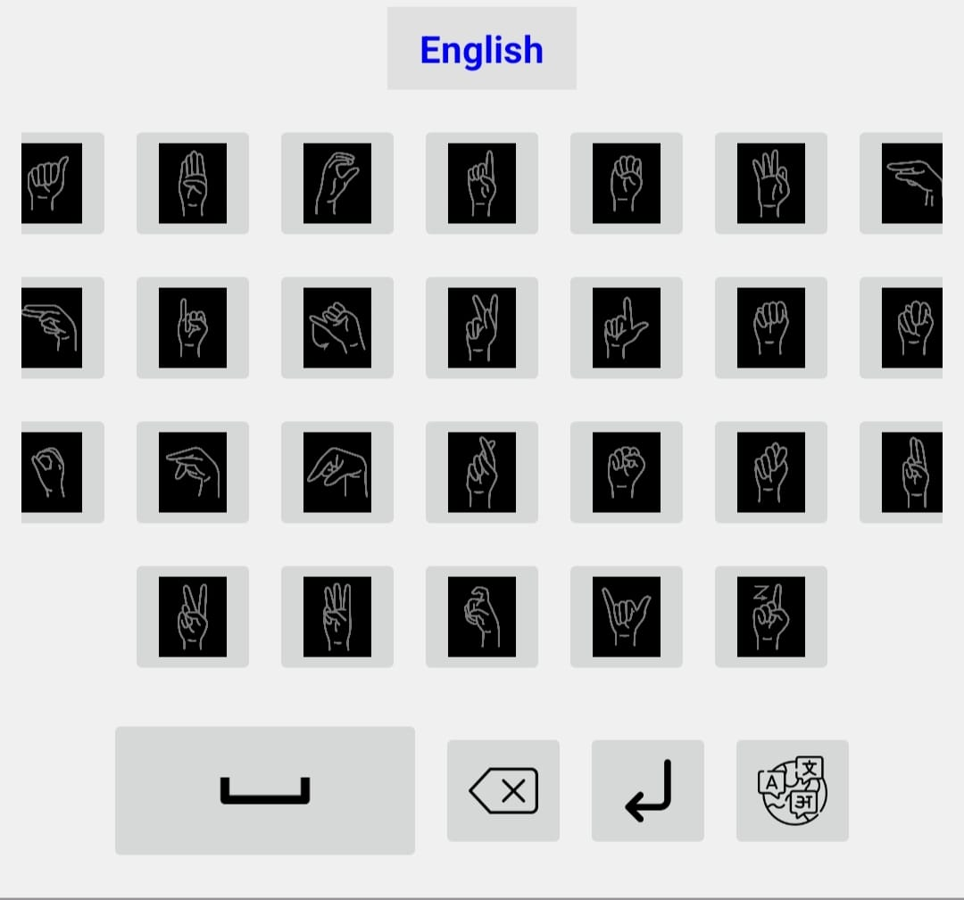
Custom Arabic & English Keyboard
A custom in-app sign language keyboard built using a dynamic LinearLayout, supporting English and Arabic letters with smooth animations, language toggling, system keyboard integration, visual button feedback, and direct EditText text manipulation.

Slide 50
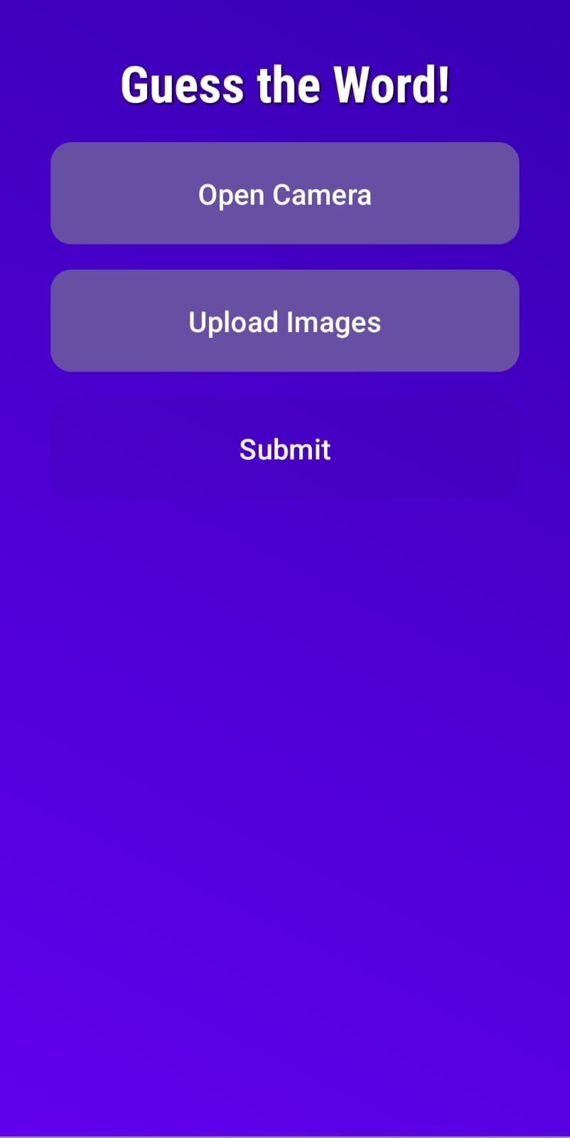
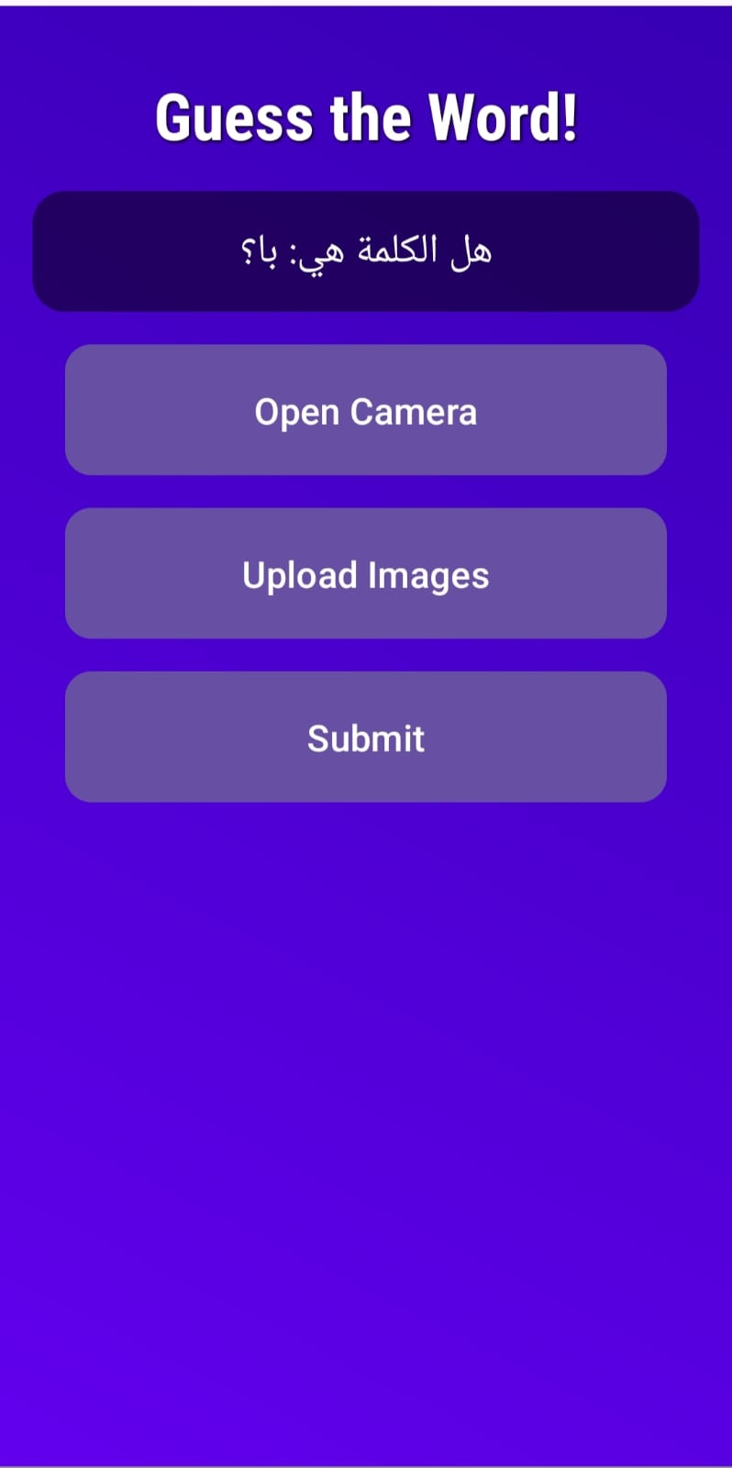
Guess the word
GuessWordActivity allows users to recognize sign language through the camera or uploaded images using CameraX and a custom recognizer; detected signs are combined into a word after a short pause, with clean permission handling, real-time preview, and image analysis via coroutines.

Slide 51
Key Features Favorites and Block Lists
.
First, I have developed a key social features of the Android mobile application using Kotlin and Supabase. These features enhance user experience by enabling friend management, favorite contacts, and blocking functionality, synced live with our cloud-based Postgres DB.

Slide 52
Database Design
Supabase-powered PostgreSQL schema was designed to handle user interactions, based on normalized tables:
Main Tables:
user_data: Contains basic profile information.
favorites: Stores each user’s favorite contacts.
block_list: Tracks which users a person has blocked.
friends: Handles friend connections

Slide 53
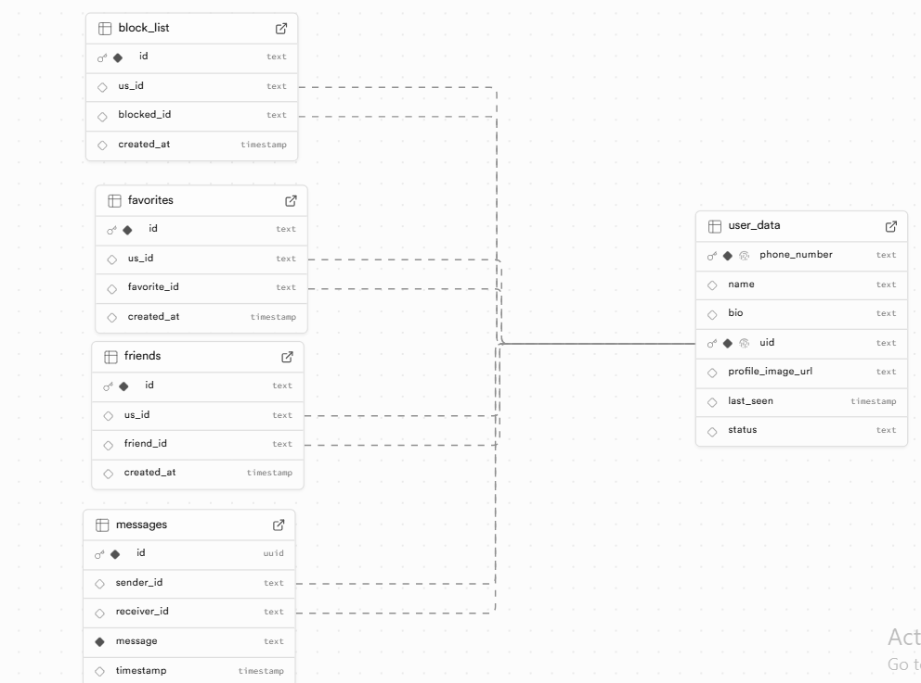

Slide 54
Functionality Implemented
val favorites = Supabase.client.postgrest["favorites"]
.select { eq("us_id", userId) }
.decodeList<Favorite>()
Favorites:
Users can add/remove others from their favorites
UI shows favorite contacts with profile image and phone number
Real-time updates using Supabase’s PostgREST and Auth.

Slide 55
Block List:
Users can block/unblock others.
Feature | Stack
UI | Kotlin + RecyclerView + Glide
Auth | Supabase Auth (JWT-based)
DB Ops | Supabase PostgREST
Realtime Updates | Coroutines + ViewModels
Adapter Architecture | Custom FavoritesAdapter, BlockAdapter
Blocked users are filtered from search/chat.
UX optimized for simplicity and fast actions.
Supabase.client.postgrest["block_list"]
.delete {
eq("us_id", userId)
eq("blocked_id", blockedId)
}

Slide 56
Speech-to-Text Integration for Accessibility
Idea Behind This Feature:
Some users may struggle with typing (elderly, motor-impaired, illiterate), or prefer to speak. This feature enables them to send voice messages converted to text, and then those messages can be converted to animated sign language, allowing deaf users to read them visually(using ai model).

Slide 57
How It Works in Our App:
"With this feature, we break two major barriers: typing and reading. Users can speak, and the system writes. Deaf users can see animations. We bring people closer, regardless of their ability."
1. User presses the mic button.
.
2. App use speechRecognizer Api to capture and convert voice to text.
3. The converted text is inserted directly in the chat input field
4. Later, this text can be sent to the Sign Avatar Engine for Sign Language Animation.
Component | Tool/Library
Voice Recognition | android.speech.SpeechRecognizer
Language | "ar-EG" for Arabic speech
Result Display | Kotlin UI (xml)with editTextMessage.setText()
Backend Sync | Supabase PostgREST
Text-to-Animation | (Connected to Avatar via future processing)

Slide 58
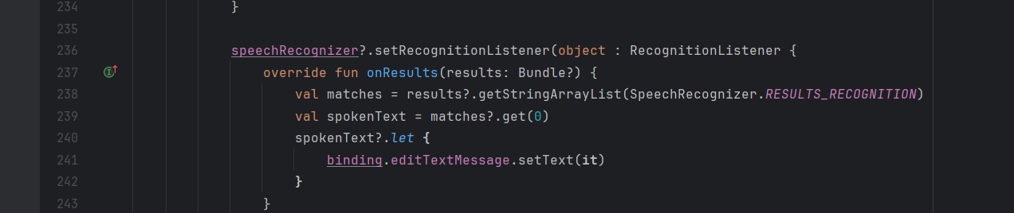
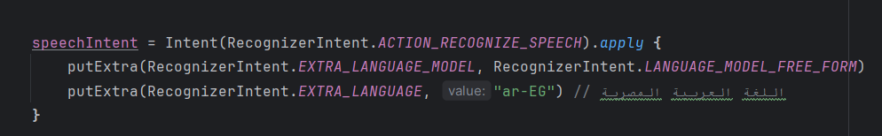

Slide 59
Voice Messaging: Record, Upload, and Chat with Audio
Feature | Technology Used
Voice Recording | AudioRecord (WAV format)
Storage | Supabase Storage
Upload Mechanism | Kotlin + Coroutines
Playback | MediaPlayer
Message UI | Custom MessageAdapter
Purpose:
To allow users to send voice messages in real-time chat, especially useful for:
Users with typing difficulties
Users who prefer to speak instead of writing
Enhancing accessibility and communication flexibility
How It Works:
User taps the microphone button
App records voice using AudioRecord into WAV format
Voice file is saved locally in the cache
File is uploaded to Supabase Storage
Public URL is embedded in the chat message
Receiver taps Play to listen using MediaPlayer

Slide 60
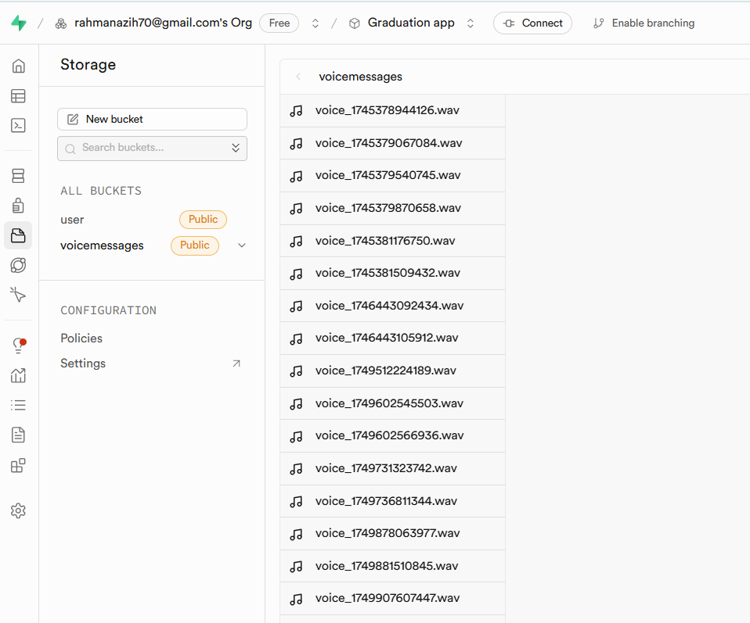

Slide 61
Presentation: Voice and Video Calling Flow
Overview:
Built using Jitsi Meet SDK for audio/video conferencing.
Firebase Realtime Database handles:
Call signaling
Call status
Real-time data syncing
Two types of calls: Video Calls Audio Calls

Slide 62
Call Flow Summary
1. User A starts a call
A unique roomId is generated.
A new node is created in Firebase:
/calls/{roomId}/signaling
Additional reference created for the receiver:
/video_calls/{receiverId} or /audio_calls/{receiverId}
2. User B receives the call
The app continuously listens on:
bash
/video_calls/{currentUserId} /audio_calls/{currentUserId}
When a call with status = "ringing" appears, an IncomingCallActivity is launched.

Slide 63
3. Accepting or Declining
If the call is accepted, status is updated:
/calls/{roomId}/signaling/status = "accepted"
The appropriate activity is launched:
VideoCallActivity for video calls
AudioCallActivity for audio calls
Starting a Video Call
VideoCallActivity is launched with roomId
JitsiMeetConferenceOptions configured with:
Camera enabled
Audio enabled
Welcome page disabled
JitsiMeetActivity.launch() starts the call UI
Starting an Audio Call
AudioCallActivity is launched with roomId
JitsiMeetConferenceOptions configured with:
Camera disabled
Audio enabled only
JitsiMeetActivity.launch() starts the call in audio-only mode

Slide 64
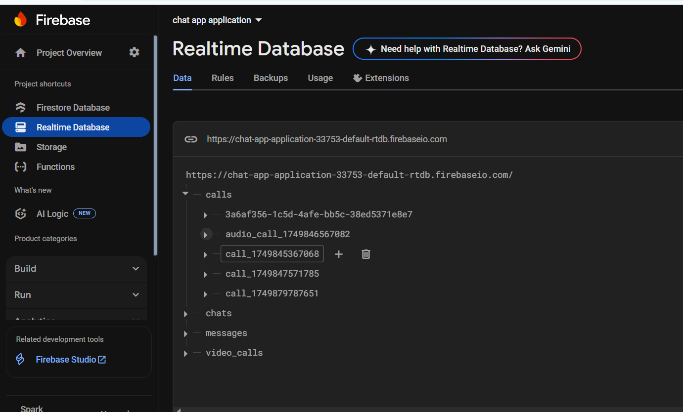
Ending the Call
When the call ends (or is rejected), the app deletes:
bash
/calls/{roomId} /video_calls/{userId} /audio_calls/{userId}
Ensures clean-up and prevents ghost calls

Slide 65
Voice-to-Sign Messaging in Chat
Allow users to speak and instantly convert their speech into sign language videos, improving accessibility and communication for deaf or hard-of-hearing users.
Component | Function
SpeechRecognizer | Converts user's voice input into text
[sign_language] Tag | Marks the message as sign-language for playback logic
Firebase Messaging | Sends the recognized message as a chat message to the recipient
SignLanguageVideoManager | Converts the recognized text into sequential sign language videos

Slide 66
Voice-to-Sign Workflow
User presses a mic button to start recording.
SpeechRecognizer listens and converts speech to text.
If speech is recognized:
Text is wrapped as [sign_language]{spokenText}
Sent to Firebase chat as a normal message
On receiving the message:
App detects the [sign_language] tag
Plays corresponding sign videos using SignLanguageVideoManager

Slide 67
SignLanguageVideoManager
Maps characters to local .mp4 sign videos.
Supports:
Arabic alphabet (أ – ي)
English alphabet (A–Z, a–z)
Plays videos sequentially in a queue.
User Talks
↓
SpeechRecognizer → Text
↓
Add [sign_language] tag
↓
Send to Firebase
↓
Receiver's Device:
→ Detects Tag
→ Converts to Video Queue
→ Plays Sign Language Videos

Slide 68
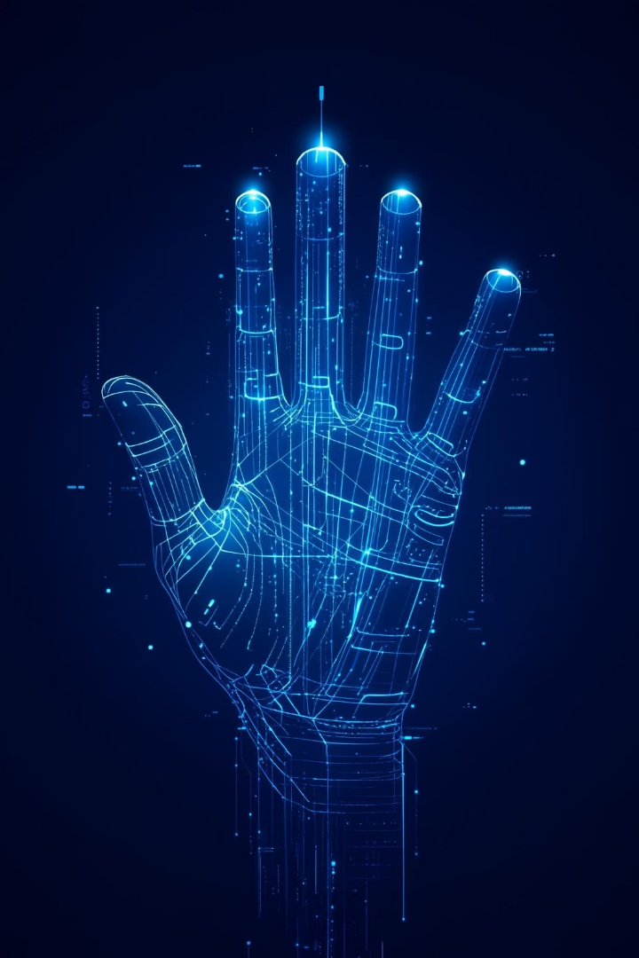
Future Work.
Continuous Recognition
Extend to full sentences and video streams.
Augmented Data
Larger, more diverse ArSL corpus.
Multimodal Integration
Facial expressions, body pose cues.
Adaptive Personalization
User-specific calibration for accuracy.

Slide 69
Future Work. Cont.
Building on our accomplishments, we identify several avenues for further enhancement:
Continuous and Sentence-Level Recognition: Extend from isolated letters to continuous sign sequences and full sentences by incorporating temporal models (e.g., 3D-CNNs, LSTM/Transformer architectures) and segmenting gestures in video streams.
Augmented Data Collection: Curate and annotate a larger, more diverse ArSL corpus—covering different dialects, backgrounds, and lighting conditions—to improve model robustness and reduce class imbalance.
Multimodal Integration: Incorporate facial-expression and body‐pose cues (non-manual signals) via face-landmark detection and full-body pose estimation to capture grammatical and emotive components of ArSL.
Adaptive Personalization: Implement on-device fine-tuning or user-specific calibration to accommodate individual variations in hand shape and signing style, improving per-user accuracy.
Cloud-Edge Hybrid Deployment: Explore a hybrid architecture leveraging edge inference for low-latency feedback and optional cloud-based processing for resource-intensive tasks (e.g., heavy fine-tuning, large-vocabulary translation).
User Experience Studies: Conduct extensive usability and accessibility studies with members of the deaf community to refine UI/UX, evaluate the value of bi-directional communication, and guide further feature development.

Slide 70
CONCOLUSION
In conclusion, combining rigorous data preprocessing, lightweight transfer-learning architectures, and interactive application design yields an effective, portable solution for bridging communication gaps between deaf ArSL users and the hearing community.

Slide 71

THANKS!
Any Questions..?

